Slide 1
Analyze Sentiment behind Amazon Reviews
Shop now!
By Divya Uppal

Slide 2
”
Brand monitoring and reputation management by analyzing customer reviews given by online shoppers.

Slide 3
PIPELINE
01
02
03
Data Collection & Cleaning
Pre-processing ( lemmatization, remove stop words & punctuation ,tokenization)
Rule based Sentiment Analysis
(Vader and Text Blob)
04
05
Count Vectorizer and TF-IDF
Machine Learning based Sentiment Analysis (Logistic Regression, Naive Bayes, Random Forest)

Slide 4
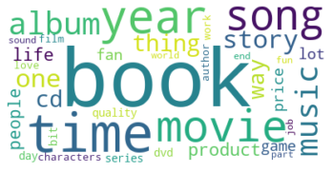
01. ABOUT THE PROJECT
02. MAJOR REQUIREMENTS
03. PROJECT GOALS
Top Nouns in Amazon Reviews (spaCy)
You could describe the topic of the section here
You could describe the topic of the section here
You could describe the topic of the section here

Slide 5
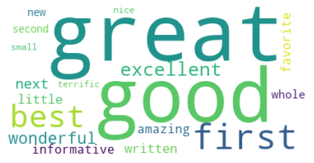
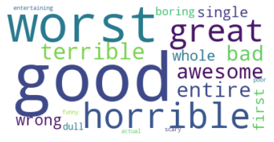
Adjective associated with Noun: Book

Slide 6

Negative Adjective: Good & Great
I read this whole series, and it had its moments of greatness as well as its moments of difficulty. This last book was going great until the author decided she had met her page quota and ended it just as the climax was coming into its own... save your self some trouble and avoid this one, and rejoice that you still have that time to read a good book.
I have a penchant for fantasy, even as an adult, and am always looking for a good fantasy book. This did not fit the bill. The language was simple, dull, and boring. I couldn't even get through the first quarter of the book. Not worth the money at all.
Vader Score: .615
TextBlob Score: .1077
ML Based Model: Classify: Negative

Slide 7
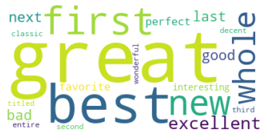
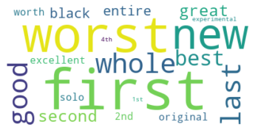
Adjective associated with Noun: Album

Slide 8
Negative Adjective: Good
Alanis must of run out of Ideas for songs on this roast beef hash of an album. The only reason I gave it 2 stars is because it has 5 good songs (out of 17 songs). This album is 71 minutes of Jagged Little Pill rehash. The lack of uninvited" on this album only helps to make this album worse. Alanis is a highly overrated musician. Anybody can release one good album and one good single.
Vader Score: .7096
TextBlob Score: .155
ML Based Model: Classify: Negative

Slide 9
Positive Words
Negative Words
disappointing
awful
okay
disappointment
one worst
poorly
boring
terrible
worst
useless
ridiculous
waste money
sucks
sadly
avoid
one star
beware
poor
well worth
pleased
awesome
long time
favorites
incredible
helps
brings
wonderful
excellent
helped
provides
beautifully
powerful
loves
greatest
highly recommended

Slide 10
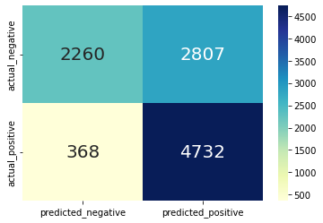
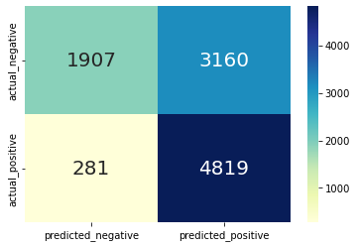
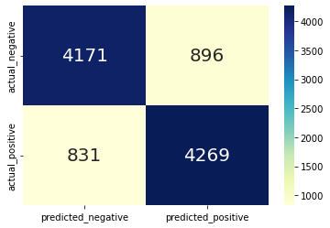
Confusion Matrix
Vader
Text Blob
Logistic Regression

Slide 11
Performance Review
 | Vader | Text Blob | Logistic Regression | Logistic Regression & Lemmatization | Random Forest | Naive Bayes
Accuracy | .688 | .662 | .830 | .817 | .821 | .806
Precision | .628 | .604 | .827 | .816 | .817 | .814
Recall | .928 | .945 | .837 | .820 | .830 | .796
F1 Score | .749 | .737 | .832 | .818 | .823 | .805

Slide 12
Thank You!!!!

